Slide 1
LECTURE 5 :
PORTFOLIO THEORY
(Asset Pricing and Portfolio Theory)

Slide 2
Contents
Principal of diversification
Introduction to portfolio theory (the Markowitz approach) – mean-variance approach
  Combining risky assets – the efficient frontier
  Combining (a bundle of) risky assets and the risk free rate – transformation line
  Capital market line (best transformation line)
  Security market line
Alternative (mathematical) way to obtain the MV results
  Two fund theorem
  One fund theorem

Slide 3
Introduction
How should we divide our wealth ? – say £100
Two questions :
    Between different risky assets (σ’s > 0)
    Adding the risk free rate (σ = 0)
Principle of insurance is based on concept of ‘diversification’
  → pooling of uncorrelated events
  → insurance premium relative small proportion of the value of the items (i.e. cars, building)

Slide 4
Assumption : Mean-Variance Model
Investors :
  prefer a higher expected return to lower returns
    ER_{A} ≥ ER_{B}
  Dislike risk
    var(R_{A}) ≤ var(R_{B}) or SD(R_{A}) ≤ SD(R_{B})
Covariance and correlation :
Cov(R_{A}, R_{B}) = ρ SD(R_{A}) SD(R_{B})

Slide 5
Portfolio : Expected Return and Variance
Formulas (2 asset case) :
Expected portfolio return : ER_{p} = w_{A} ER_{A} + w_{b} ER_{B}
Variance of portfolio return :
var(R_{p}) = w_{A}² var(R_{A}) + w_{B}² var(R_{B}) + 2w_{A}w_{B}Cov(R_{A},R_{B})
Matrix notation :
Expected portfolio return : ER_{p} = w’ER_{i}
Variance of portfolio return : var(R_{p}) = w’Σw
where w is (nx1) vector of weights
ER_{i} is (nx1) vector of expected returns of individual assets
Σ is (nxn) variance covariance matrix

Slide 6
Minimum Variance ‘Efficient’ Portfolio
2 asset case : w_{A} + w_{B} = 1 or w_{B} = 1 – w_{A}
var(R_{p}) = w_{A}² σ_{A}² + w_{B}² σ_{B}² + 2w_{A} w_{B} ρσ_{A}σ_{B}
var(R_{p}) = w_{A}² σ_{A}² + (1-w_{A})² σ_{B}² + 2w_{A} (1-w_{A}) ρσ_{A}σ_{B}
To minimise the portfolio variance : Differentiating with respect to w_{A}
∂σ_{p}²/∂w_{A} = 2w_{A}σ_{A}² – 2(1-w_{A})σ_{B}² + 2(1-2w_{A})ρσ_{A}σ_{B} = 0
Solving the equation :
w_{A} = [σ_{B}² – ρσ_{A}σ_{B}] / [σ_{A}² + σ_{B}² – 2ρσ_{A}σ_{B}]
= (σ_{B}² – σ_{AB}) / (σ_{A}² + σ_{B}² – 2σ_{AB})

Slide 7
Power of Diversification
As the number of assets (n) in the portfolio increases, the SD (total riskiness) falls
Assumption :
  All assets have the same variance : σ_{i}² = σ²
  All assets have the same covariance : σ_{ij} = ρσ²
  Invest equally in each asset (i.e. 1/n)

Slide 8
Power of Diversification (Cont.)
General formula for calculating the portfolio variance
  σ²_{p} = Σ w_{i}² σ_{i}² + ΣΣ w_{i}w_{j} σ_{ij}
Formula with assumptions imposed
  σ²_{p} = (1/n) σ² + ((n-1)/n) ρσ²
  If n is large (1/n) is small and ((n-1)/n) is close to 1.
  Hence : σ²_{p} ≈ ρσ²
  Portfolio risk is ‘covariance risk’.

Slide 9
Random Selection of Stocks
Standard deviation
Diversifiable /
idiosyncratic risk
C
Market / non-diversifiable risk
0 1 2 ...
20
40
No. of shares in portfolio

Slide 10
Example : 2 Risky Assets
 | Equity 1 | Equity 2
Mean | 8.75% | 21.25%
SD | 10.83% | 19.80%
Correlation | -0.9549
Covariance | -204.688

Slide 11
Example : Portfolio Risk and Return
 | Share of wealth in |  | Portfolio
 | w₁ | w₂ | ER_{p} | σ_{p}
1 | 1 | 0 | 8.75% | 10.83%
2 | 0.75 | 0.25 | 11.88% | 3.70%
3 | 0.5 | 0.5 | 15% | 5%
4 | 0 | 1 | 21.25% | 19.80%

Slide 12
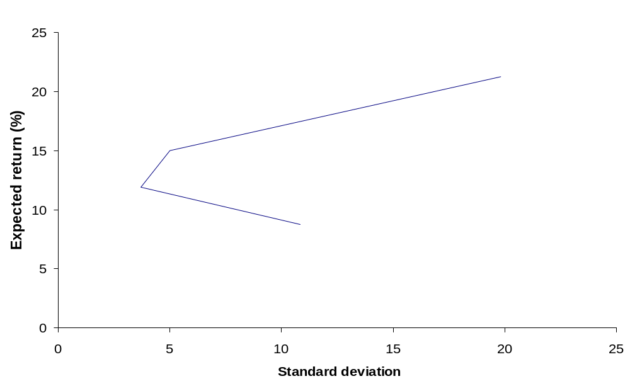
Example : Efficient Frontier
0, 1
0.5, 0.5
1, 0
0.75, 0.25

Slide 13
Efficient and Inefficient Portfolios
ER_{p}
U
A
μ_{p*} = 10%
x
x
x
L
x
μ_{p**} = 9%
x
B
x
x
P₁
x
x
x
x
x
P₁
x
x
x
x
x
C
σ_{p**}
σ_{p*}
σ_{p}

Slide 14
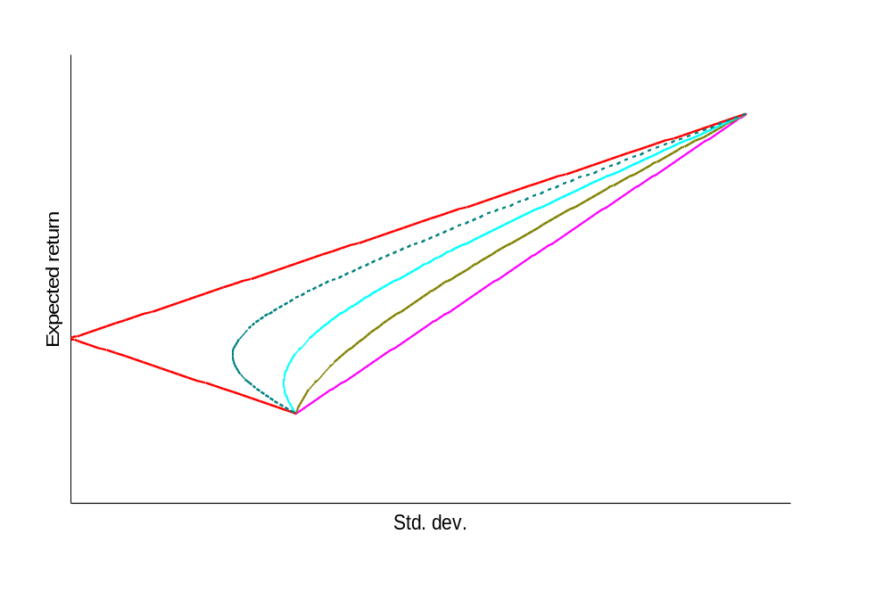
Risk Reduction Through Diversification
Y
ρ = -0.5
ρ = -1
ρ = +1
B
A
ρ = 0.5
Z
ρ = 0
C
X

Slide 15
Introducing Borrowing and Lending : Risk Free Asset
Stage 2 of the investment process :
  You are now allowed to borrow and lend at the risk free rate r while still investing in any SINGLE ‘risky bundle’ on the efficient frontier.
  For each SINGLE risky bundle, this gives a new set of risk return combination known as the ‘transformation line’.
  Rather remarkably the risk-return combination you are faced with is a straight line (for each single risky bundle) - transformation line.
  You can be anywhere you like on this line.

Slide 16
Example : 1 ‘Bundle’ of Risky Assets + Risk Free Rate
 | Returns
 | T-Bill (safe) | Equity (Risky)
Mean | 10% | 22.5%
SD | 0% | 24.87%

Slide 17
‘Portfolio’ of Risky Assets and the Risk Free Asset
Expected return
  ER_{N} = (1 – x)r_{f} + xER_{p}
Riskiness
  σ²_{N} = x²σ²_{p} or σ_{Ν} = xσ_{p}
where
x = proportion invested in the portfolio of risky assets
ER_{p} = expected return on the portfolio containing only risky assets
σ_{p} = standard deviation of the portfolio of risky assets
ER_{N} = expected return of new portfolio (including the risk free asset)
σ_{N} = standard deviation of new portfolio

Slide 18
Example : New Portfolio With Risk Free Asset
 | Share of wealth in |  | Portfolio
 | (1-x) | x | ER_{N} | σ_{N}
1 | 1 | 0 | 10% | 0%
2 | 0.5 | 0.5 | 16.25% | 12.44%
3 | 0 | 1 | 22.5% | 24.87%
4 | -0.5 | 1.5 | 28.75% | 37.31%

Slide 19
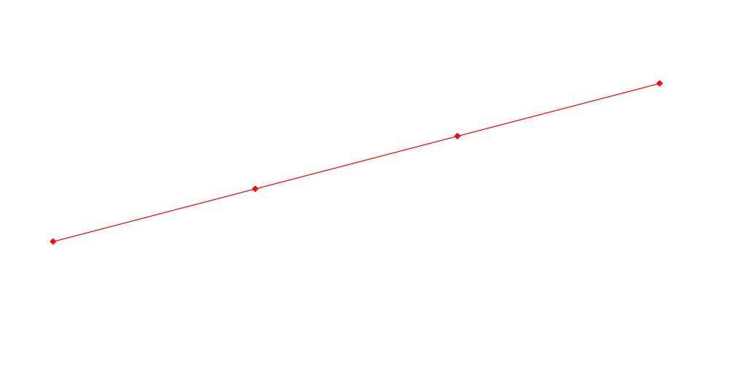
Example : Transformation Line
0.5 lending +
0.5 in 1 risky bundle
No borrowing/
no lending
-0.5 borrowing +
1.5 in 1 risky bundle
All lending
Standard deviation (Risk)

Slide 20
Transformation Line
Expected Return, μ_{N}
Borrowing/
leverage
Z
Lending
X
all wealth in risky asset
L
Q
r
all wealth in
risk-free asset
σ_{X}
Standard Deviation, σ_{N}

Slide 21
The CML – Best Transformation Line
Transformation line 3
– best possible one
ER_{p}
Portfolio M
Transformation line 2
Transformation line 1
r_{f}
Portfolio A
σ_{p}

Slide 22
The Capital Market Line (CML)
Expected return
CML
Market Portfolio
Risk Premium / Equity Premium
(ER_{m} – r_{f})
r_{f}
20
Std. dev., σ_{i}

Slide 23
The Security Market Line (SML)
Expected return
SML
Market Portfolio
Risk Premium / Equity Premium
(ER_{i} – r_{f})
r_{f}
0.5
1
1.2
Beta, β_{i}
The larger is β_{i}, the larger is ER_{i}

Slide 24
Risk Adjusted Rate of Return Measures
Sharpe Ratio : SR_{i} = (ER_{i} – r_{f}) / σ_{i}
Treynor Ratio : TR_{i} = (ER_{i} – r_{f}) / β_{i}
Jensen’s alpha :
  (ER_{i} – r_{f})_{t} = α_{i} + β_{i}(ER_{m} – r_{f})_{t} + ε_{it}
Objective :
  Maximise Sharpe ratio (or Treynor ratio, or Jensen’s alpha)

Slide 25
Portfolio Choice
I_{B}
Z’
ER
Capital Market Line
K
I_{A}
M
Y
ER_{m}
ER_{m} - r
A
Q
r
α
L
σ_{m}
σ

Slide 26
Math Approach

Slide 27
Solving Markowitz Using Lagrange Multipliers
Problem : min ½(Σw_{i}w_{j}σ_{ij})
  Subject to
  Σw_{i}ER_{i} = k (constant)
  Σw_{i} = 1
Lagrange multiplier λ and μ
  L = ½ Σw_{i}w_{j}σ_{ij} – λ(Σw_{i}ER_{i} – k) – μ(Σw_{i} – 1)

Slide 28
Solving Markowitz Using Lagrange Multiplier (Cont.)
Differentiating L with respect to the weights (i.e. w₁ and w₂) and setting the equation equal to zero
For 2 variable case
  σ₁²w₁ + σ₁₂w₂ – λk₁ – μ = 0
  σ₂₁w₁ + σ₂²w₂ – λk₂ – μ = 0
    The two equations can now be solved for the two unknowns λ and μ.
    Together with the constraints we can now solve for the weights.

Slide 29
The Two-Fund Theorem
Suppose we have two sets of weight : w¹ and w² (obtained from solving the Lagrangian), then
αw¹ + (1-α)w²
for -∞< α < ∞ are also solutions and map out the whole efficient frontier
Two fund theorem :
  If there are two efficient portfolios, then any other efficient portfolio can be constructed using those two.

Slide 30
One Fund Theorem
With risk free lending and borrowing is introduced, the efficient set consists of a single line.
One fund theorem :
  There is a single fund M of risky assets, so that any efficient portfolio can be constructed as a combination of this fund and the risk free rate.
  Mean = αr_{f} + (1-α)μ
  SD = ασ_{rf} + (1-α)σ

Slide 31
References
Cuthbertson, K. and Nitzsche, D. (2004) ‘Quantitative Financial Economics’, Chapter 5
Cuthbertson, K. and Nitzsche, D. (2001) ‘Investments : Spot and Derivatives Markets’, Chapters 10 and 18

Slide 32
END OF LECTURE

